Slide 1


Fleet Feet Social Media Plan
Benjamin Zimmerman

Slide 2
Social Strategy
Social Media Objective: Increase New Consumers coming to Fleet Feet through social media and create a sense of community through their channels. SMART Goal: Increase engagement on Instagram, TikTok, and X by 10%, over a span of six months, ending in early spring
Internal
What works/What is not:
Instagram: 18,500 followers, 1.6% engagement rate on daily posts, 27% with marathon related posts.
TikTok: 128 followers, high view rates on many videos, up to 14,900 views.
Facebook: Not Prioritized, No Prescence
X: 14,500 followers, >1% engagement rate, no consistent strategy.
Brand Points of Difference/Brand Story
Community: Known for building a community around running for runners.
Technology: 3D Foot scanning technology allows for the best shoe fit possible.
Local Company: founded in 1996 and grown to 7 stores promoting running communities in Chicago.
Critically Acclaimed: consistently voted as one of the top 50 running stores in America.
Competitor
What works/what does not:
Instagram: Nearly 5,000 followers, 16.1% engagement rate.
Facebook: 16,000 followers, 2.18% engagement rate
TikTok and X: No Accounts

Slide 3
Competitor Analysis: Dick Pond Athletics
Channel(s) | Followers | Engagement %? | What type of content or topics are they posting/tweeting? | Content format…video, photos, events, articles. | Use of Influencers?
Facebook | 16,000 | 2.18% | Informational, mostly about race events and giving back to the community | Mainly photos | No Influencer Use
Instagram | 4,971 across 5 accounts | 16.1% across all accounts | Informational, race events and discounts, along with local food drives. | Mainly pictures and carousel related posts | No Influencer Use
TikTok | No TikTok Prescence | 0% | - | - | -
X | No X Prescence | 0% | -. | - | -

Slide 4
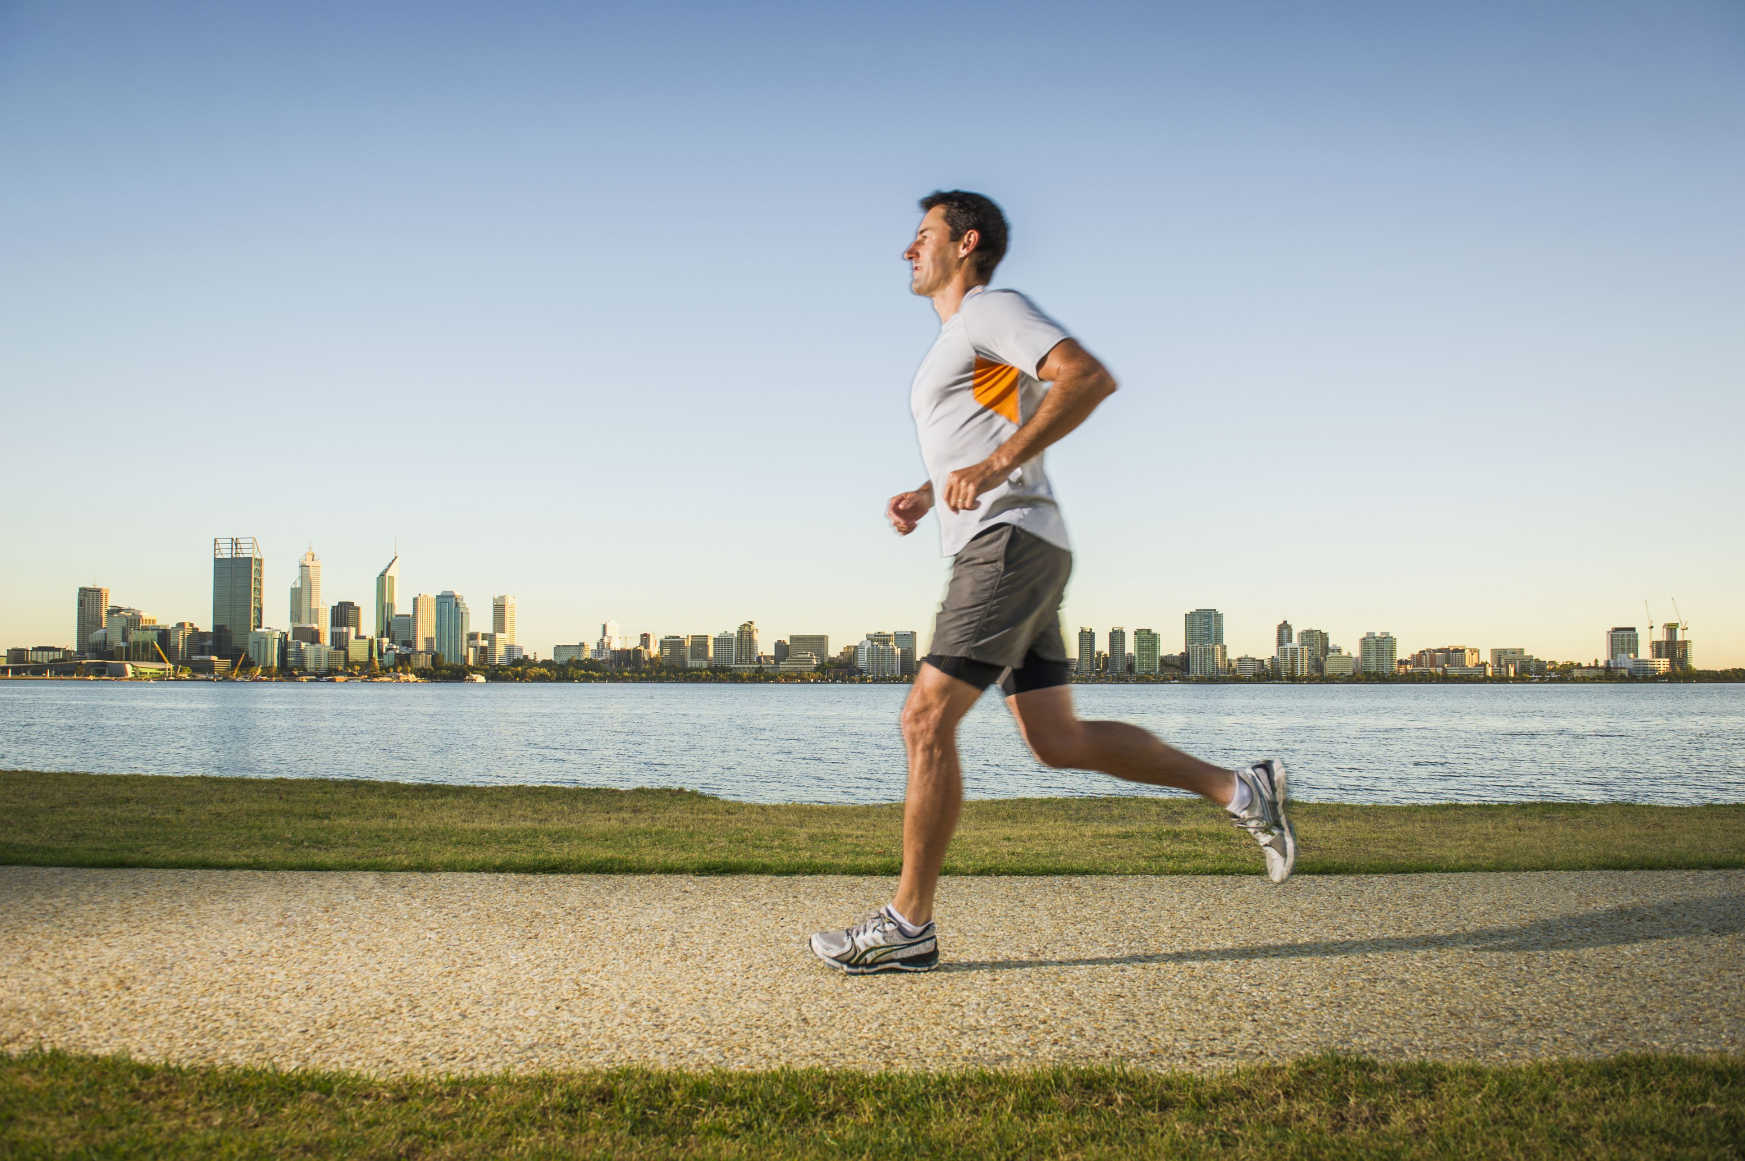

Social Strategy (Audience)
Meet John, a 30-year-old Chicagoan living in Lakeview East and working full-time as an Insurance Salesperson at a large insurance company. John makes about $80,000 a year and loves Lifting, Run Clubs, and the Chicago Marathon. He has heard of Fleet Feet before, but never shopped there and usually buys his running shoes online. John is looking for a running community with people of all ages, to broaden his running connections and friends. John has been burned in the past with his online purchases, with shoes not fitting right and he ends up with buyer’s remorse as a result. John is looking for a store that is more than a store, that also offers a community.

Slide 5
Strategy (Brand Persona)
Brand Voice
Description | Do’s | Don’ts
1)Approachable- We want everybody to feel welcome in our community. | Create a warm and welcoming environment | Fall into clique culture
2) Trustworthy – We want to set ourselves apart from online alternatives who sound untrustworthy | Listen and respond to constructive criticism | Ignore customer sentiments
3) Knowledgeable- We want people to know about our science-based approach to shoes. | Show technology that knows exactly what customers want | Make the technology sound all knowing
Why did you choose these?
We chose being approachable, trustworthy, and knowledgeable as being most important to Fleet Feet because to build sense of community, we believe these attributes to be most important.

Slide 6



Chosen Focus Channels

Slide 7
Strategy (Focus Channels)
Social Channel Priority (where to focus)
Social Channel | Why did you choose? (rationale needs to link to previous steps)
 | Fleet Feet has its highest amount of followers on Instagram, with 18,500 followers and a daily engagement rate of 1.6%. However, the Instagram channel shines during the Marathon season of Chicago. Here, engagement jumps up to 27%, and with these high engagement rates, the Instagram channel can be used to create a true community feel to the Fleet Feet Instagram channel. If Fleet Feet wishes to build a community feel in its stores and bring people together in more ways than a store will, it must tap into the engagement rate it receives during the Chicago Marathon, by promoting run clubs and local races, as well as giving back to the Chicago community.

Slide 8
Strategy (Focus Channels)
Social Channel Priority (where to focus)
Social Channel | Why did you choose? (rationale needs to link to previous steps)
 | X is a great platform to promote Fleet Feet Chicago on. Currently, it has the second highest following of all Fleet Feet channels, with 14.5 thousand followers. However, there are close to zero engagements. X is a platform that needs much direction if it is to flourish. Only 25% of adults aged 30-49 use X, however with an already established channel, there needs to be direction with the platform to create a community on the X channel. One way to do this could be to promote run club and race meet ups made by people in the running community.

Slide 9

Strategy (Focus Channels)
Social Channel Priority (where to focus)
Social Channel | Why did you choose? (rationale needs to link to previous steps)
 | TikTok has high view counts with Fleet Feet’s accounts, however with 128 followers on the platform, it may be hard to gain traction. However, our local competitors have no TikTok presence. Some of the account’s videos have nearly 15,000 views, so there is an audience for Fleet Feet on TikTok. 40% of people aged 30-49 use TikTok, and without competition on the app, we have a potentially large group of potential engagements. However, we have loyal followers on our account already, so building a community on TikTok is an issue of scaling.

Slide 10
Content Pillars
Mission/Point of Difference: Creating community around it’s technologically advanced and passionately local owned businesses.
Push: 3-D Foot Scanning technology that scans your feet to find the perfect shoe for whatever athletic situation you need. Then the perfect shoe is picked from a stock of the best running shoes on the market.
Pull: The customer journey that Fleet Feet gives is one that many runners and athletes are searching for. The amount of care and precision taken for each person to find the perfect product is something that sets Fleet Feet apart from others, giving them a more personable atmosphere.
Pull: The community that Fleet Feet strives for consistently is far more than larger online stores will ever do. As a local company, it allows them to grow closer to their consumers and truly hear what they want and need from their running store and connect with others who have the same interests on the same level that they do.

Slide 11
Campaign Idea: Show us Your Fleet Feet
The Show us your Fleet Feet campaign is designed for the followers of the fleet feet social medias to show off their running shoes and customize them, bringing both individuality and community to the Fleet Feet channels. Running on Instagram, Tiktok, and X, this campaign will use the #showthefleetfeet, and will have the viewers send in videos or photos of customized and individual running shoes that they create, with the most creative winning a free pair of shoes from Fleet Feet, with other swag being given out to the number 2 and 3 placing creations. The winner will be decided by the community voting through liking and commenting on their favorite pair. This campaign hinges on user created content, but influencers will also be used as well as paid media advertising the challenge. This campaigns main goal is to drive engagement on Fleet Feet’s social media channels, so to enter formally, they must send their entry directly to the Fleet Feet account of their choice.

Slide 12
Paid, Owned, Earned
Paid: The Paid media will be used to generate interest in the “show us your fleet feet” contest on TikTok and instagram, advertising the prize, especially highlighting the personalized care used to determine which shoe is best for each individual, and directing consumers to the social media post explaining the rules of the competition.
Owned: The Owned media will be promoting the competition to people already following Fleet Feet’s social media channels. Also, all entries will be voted on off Fleet Feet’s channels, allowing for an increase in engagement. However, this does not come at a cost of Earned Media.
Earned: The earned media will be focused on the user creations made as entry into the competition. If the contestant posts their creation on their own account with the #showthefleetfeet tag, the likes and comments of that post will be counted towards their total votes, although they still have to send their entry to the Fleet Feet channels. This provides the contestant with incentive to create earned media, giving us engagement growth while giving them a larger chance to win the grand prize.

Slide 13
Influencer #1: Stan Murphy
Stan Murphy is the first influencer we want to get in on the Show Us Your Fleet Feet Campaign. With a focus on family and nutritional content on Instagram, and with just over 130,000 followers, he is the perfect mid-size influencer for Fleet Feet. His CPM is under the Benchmark, and he gets around 8.65% engagement percentage. His cost is also very good for a mid-sized influencer, at just over $2,000 for a total deal. Stan is easy to work with and produces high end content. We are choosing him due to his ability to curate a community, shown by his high engagement rate, his competitive pricing, and his passion for creating high end content for his community to enjoy.

Slide 14
Influencer #2: Simon Peter
The Second influencer for the Fleet Feet campaign will be Simon Peter. He also has great ability to create and maintain a community, with an engagement rate of 14.61%, which is great considering his following of over 200,000 running afficionados. His CPM is a bit higher than benchmark, at 7.67. However, he also creates high quality content and is very easy to work with. Therefore, we are recommending Simon Peter because of his high engagement rate with our target audience, and his high content quality showing his passion as a runner and as a creator.

Slide 15
Influencer Budget
Influencers | Cost Per Post | Upcharge Cost | Total
Stan Murphy | 2 posts at $2,200 each | $1,100 | $5,500
Simon Peter | 1 reel at $2,500 | $750 | $3,250
Total | $6,900 | $1,850 | $8,750

Slide 16
Social Media Budget
Social Media Channel | Cost | %of total budget
Influencers | $8,750 | 43.75%
Instagram | $5,625 | 28.13%
TikTok | $5,625 | 28.13%
X | 0 | 0%

Slide 17
Budget Rationale
Influencers: Utilizing influencers is one of the keys to this campaign, as the influencers chosen already have strong, established communities with high engagement rates. As the goal of this campaign is to raise engagement rates on our own channels, spending a large portion of the budget on people with strong audiences who can grow our own following and engagements is needed.
Paid Media: X: We will not be spending money on paid ads on X. We already have a large following on X, and therefore need to focus on increasing our owned media production, posting regularly and organically, and strengthening our core audience following us, instead of focusing on new audiences. Therefore, owned media production will be a priority on this channel and no paid ads will be ran on X, in favor of other channels where growing our audience will be more beneficial.
Paid Media: Instagram and TikTok: We are splitting the remainder of our budget evenly between TikTok and Instagram, as these channels are where we have seen our highest views and engagement rates in the past, as well as Instagram holding our highest follower count. As our most active platforms, our goal for these channels will be to increase followers and engagement rates through the use of paid ads promoting our Show us Your Fleet Feet Campaign.

Slide 18
Influencer Metrics and Rationale
Influencer KPIs: Engagements
Influencer Metrics: Target Average Engagement Rate of 10%
Benchmark Engagement Rate: 8%
Rationale: Engagements will be the main performance indicator of the Influencer campaign because to goal of the influencers will be get the word out about the Fleet Feet Campaign. If the engagements on Instagram reach 10% of the influencer’s audience, we will be greatly expanding the name of Fleet Feet to a far larger audience than we have had previously across all channels. The benchmark will be at 8%, lower than both influencer’s average engagement rates, Which is still far lower than our daily posts receive on the channel. We are highly optimistic about the Influencer Campaign reaching it’s goal.

Slide 19
Paid Media Metrics and Rationale
Paid Media KPI: Website Traffic
Paid Media Metrics: 0.9% Click Through rate across all paid ads
Benchmark Click Through Rate: 0.7%
Rationale: Website Traffic is the Key Metric we need to focus on with the paid advertisements, as the advertisements will all focus on the Show Us Your Fleet Feet Campaign, with the advertisement landing on the page describing the rules and prizes of the competition. Therefore, a CTR of 0.9, the average between Instagram and TikToks CTR average, is the goal. The benchmark will be at 0.7%, allowing some wiggle room as some who receive the ad may not be interested in running, or a running community.

Slide 20
Owned Media Metrics and Rationale
Owned Media KPI: Engagements
Owned Media Metrics: Increase Owned Media Engagements by 5%
Benchmarck Engagement Rate: 2%
Rationale: The main KPI on Owned Media is Engagements, and this is the main Goal of the Campaign. By posting daily and having a specific plan on owned media, X will begin to see increases in engagement, especially because it has our second highest following, while Instagram and TikTok have decent engagements, we expect to see increases. This is because all of the voting on the Show Us Your Fleet Feet campaign will be done through our own social media channels, increasing engagement while creating community through their love of running and running gear.

Slide 21
Earned Media Metrics and rationale
Earned Media KPI: User-Created Content
Earned Media Metrics: #Showthefleetfeet used 1000 across channels
Rationale: User-Generated content is another cornerstone of the campaign. The user generated content will be added to the owned media posts in the vote for the competition, giving incentive for users to promote their own creations as much as possible, giving Fleet Feet impressions through the hashtag, hence why we are using the hashtag usage as our metric, as the likes will only count towards the vote if the hashtag is used.

Slide 22
Why This Campaign Helps?
This Campaign helps the social media challenge because Fleet Feet needs to grow a community to differentiate themselves from online options and grow revenue in their market. In increasing engagement rate with their owned media, they will have a far easier time connecting with their audience and getting them into the store, driving conversions. The Competition created by the campaign will allow their consumers to not only become more connected with Fleet Feet, but with each other as well, creating a true community that the larger running brands do not have.

Slide 23
References
Hoang, Truc. “TIKTOK CTR: All You Need to Know to Improve Your Ad Performance.” Mega Digital - Digital Marketing Agency, 24 Oct. 2024, megadigital.ai/en/blog/tiktok-ctr-all-you-need-to-know-to-improve-your-ad-performance/#:~:text=A%20good%20CTR%20for%20social%20media%20ads%20depends,any%20platform%20is%20considered%20above%20the%20platform’s%20average.
“Social Media Fact Sheet.” Pew Research Center, 31 Jan. 2024, www.pewresearch.org/internet/fact-sheet/social-media/#who-uses-each-social-media-platform?tabItem=0ec23460-3241-4a1f-89bc-0c27fb641936. Accessed 28 Sept. 2024.

